Slide 1
MindScan: Identifying Mental Illness Severity using Natural Language Processing
Binary and Multiclass Classification of Reddit Social Media Posts
Presented By: Group 06
Presented To: Dr. Syed Zafi Shehran Shah

Slide 2
The Problem Statement
Mental health struggles are frequently shared on platforms like Reddit, but manual monitoring is impossible at scale.
Goal: To build an automated system that detects the severity of distress to help connect users to support faster.
Task Objectives
  Task A (Binary): Classifying posts as "Severe" (1) or "Not Severe" (0).
  Task B (Multiclass): Categorizing posts into four levels: None (0), Mild (1), Moderate (2), and Severe (3).

Slide 3
Dataset Breakdown
Task | Total Samples | Train (80%) | Val (10%) | Test (10%)
Binary | 3,263 | 1,957 | 653 | 653
Multiclass | 3,553 | 2,131 | 711 | 711

Slide 4
The Challenge: Class Imbalance
Binary Task Imbalance:
Not Severe (0): 79.25% | Severe (1): 20.75%
Multilabel Task Imbalance:
None (0): 72.78% | Mild (1): 8.16% | Moderate (2): 11.07% | Severe (3): 7.98%
Explanation: Imbalance is a problem because models tend to ignore minority classes to get high accuracy.
Our Solution: We used class_weight='balanced' in our models to force the AI to pay equal attention to severe cases.

Slide 5
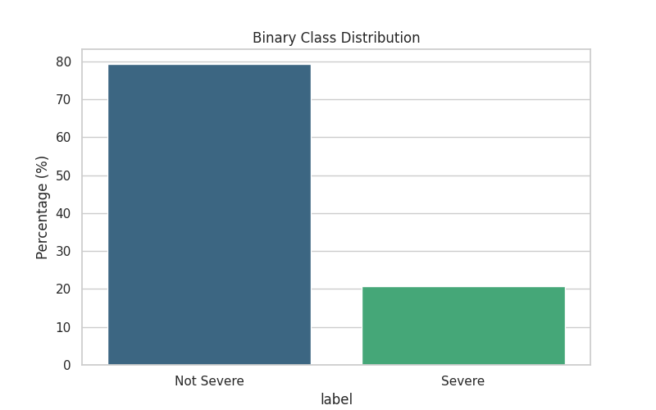
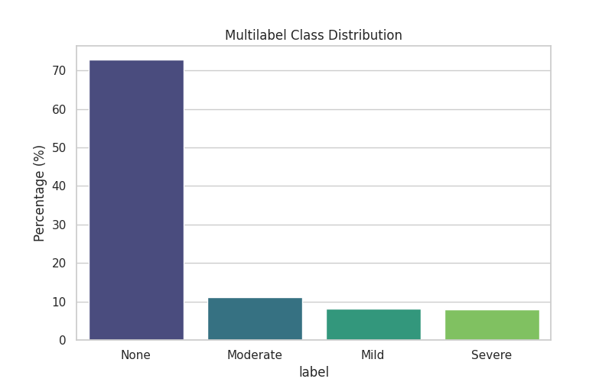
The Challenge: Class Imbalance

Slide 6
Visualizing the Language (Word Clouds)
Word clouds help identify the most frequent emotional markers in each category.
Not Severe / None: Words like "know," "think," "really," and "year" are common.
Severe: You will notice more frequent mentions of "anxiety," "feel," "never," "attack," and "help"

Slide 7
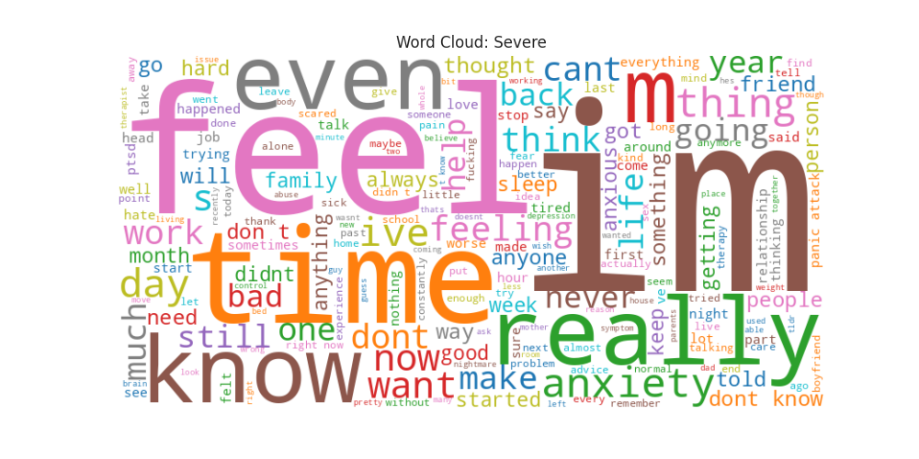
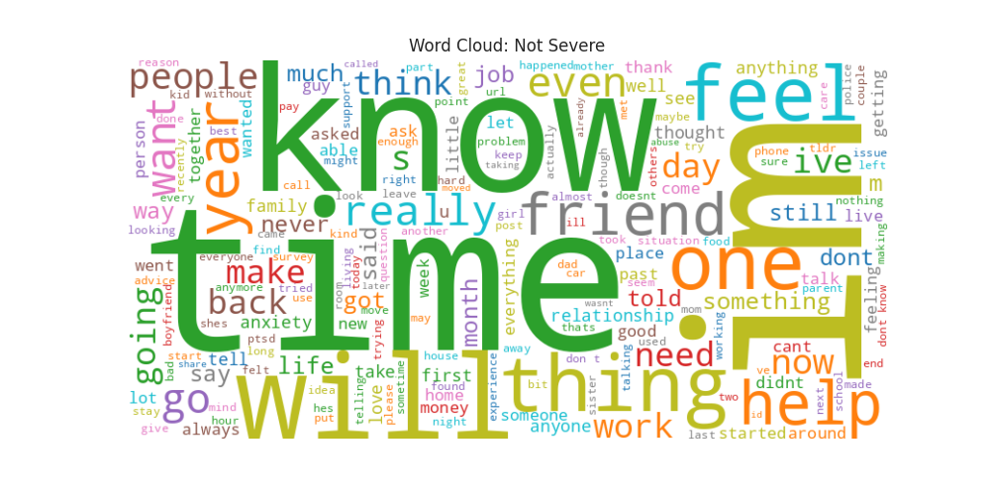
Binary Word Cloud

Slide 8
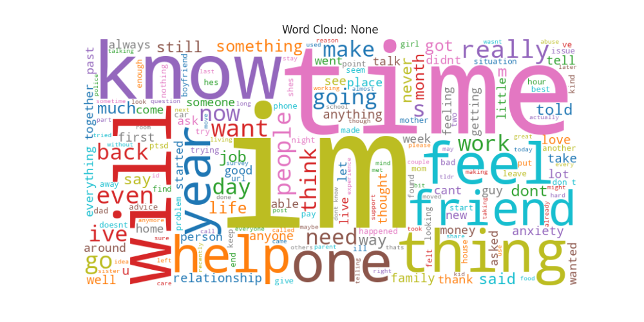
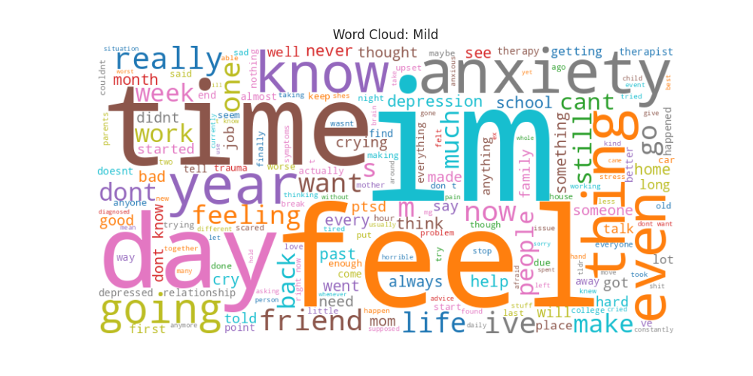
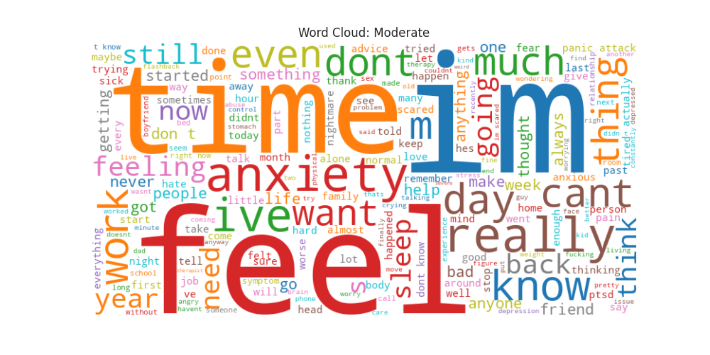
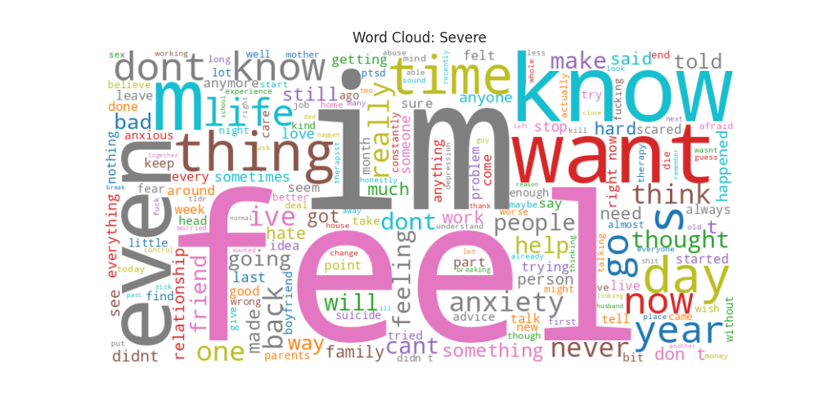
Multilabel Word Clouds

Slide 9
Unigram & Bigram Analysis
Unigrams (single words) and Bigrams (two-word phrases) provide a deeper look at the context.
Task | Category | Key Bigrams (Phrases)
Binary | Severe | "panic attack," "mental health," "feel like," "don’t know"
Multilabel | Severe | "suicidal thoughts," "hospital," "mental illness," "worst part"

Slide 10
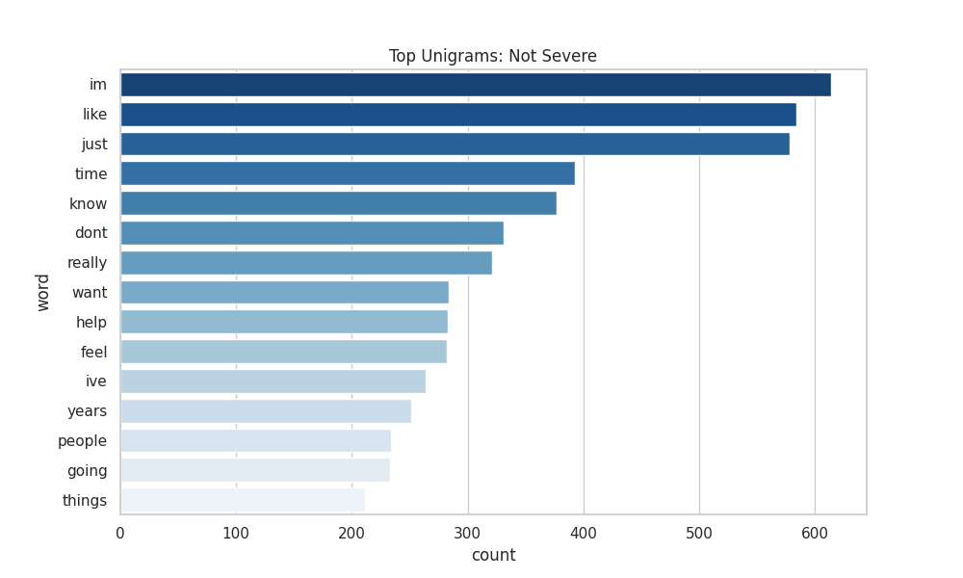
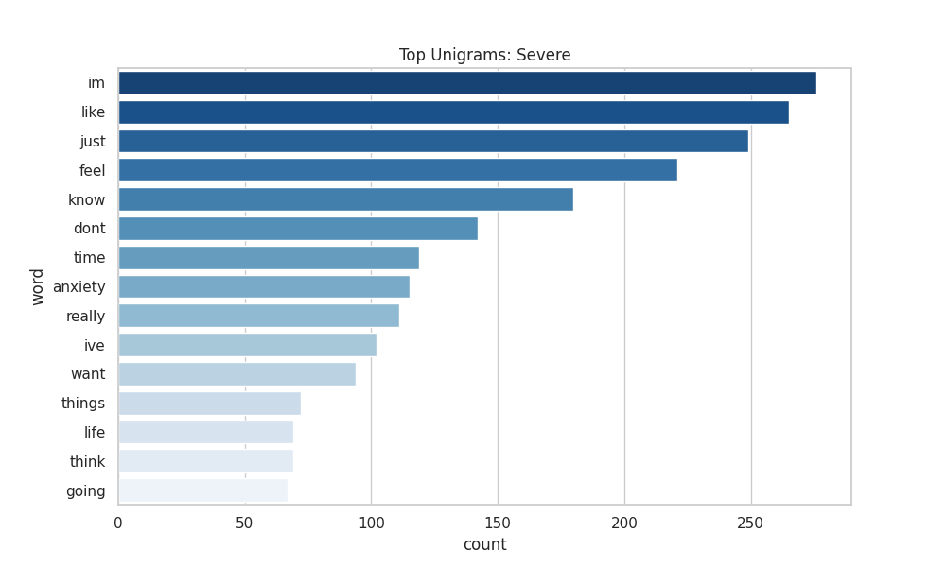
Top Unigram per Binary Class

Slide 11
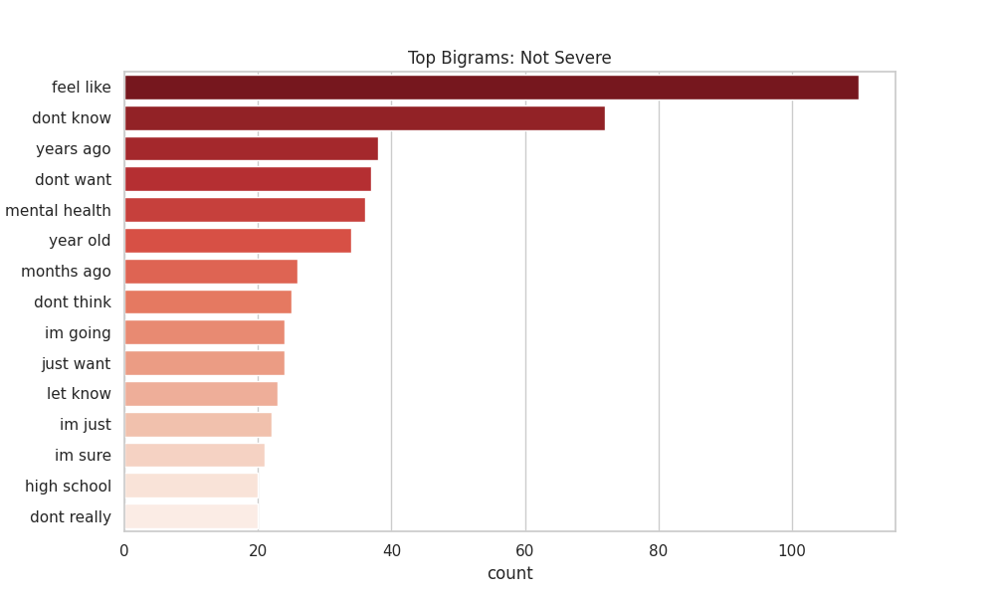
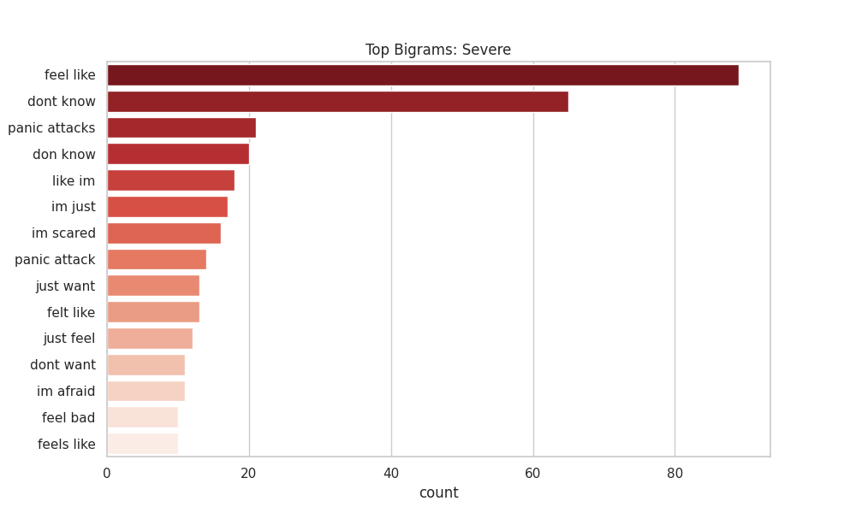
Top Bigram per Binary Class

Slide 12

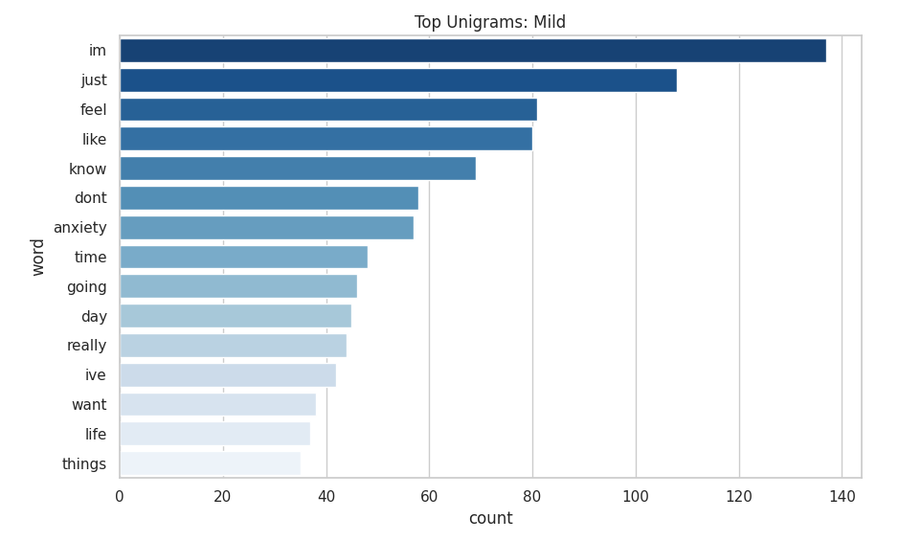
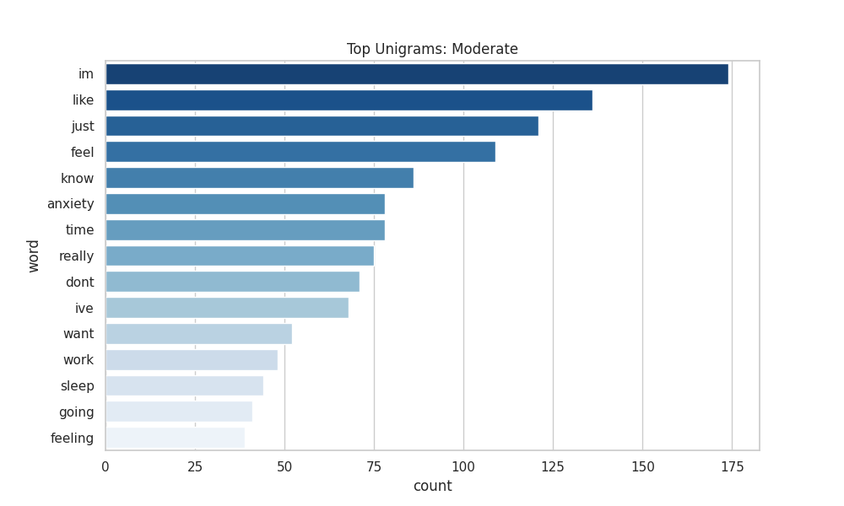
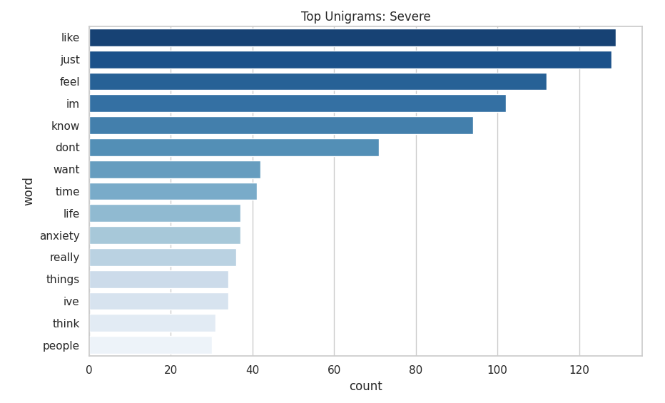
Top Unigram per Multilabel Class

Slide 13

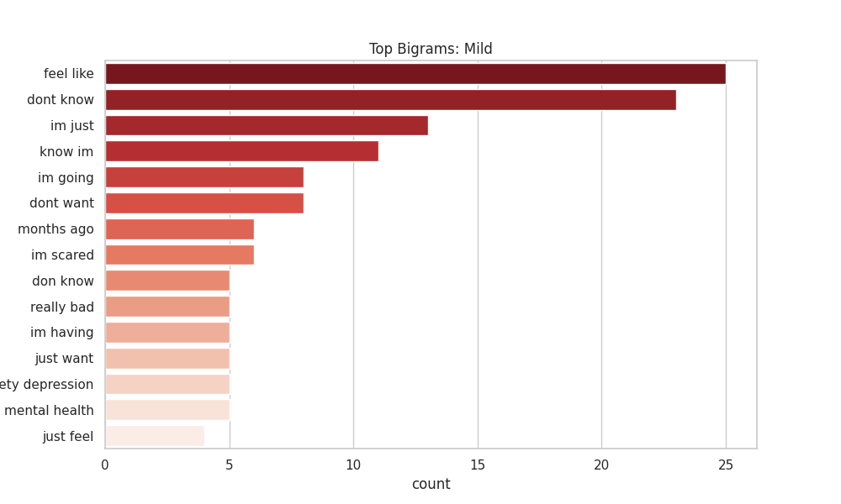
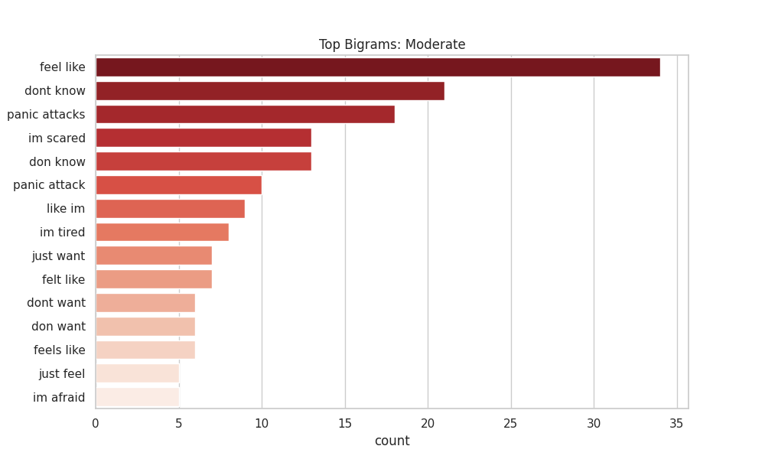
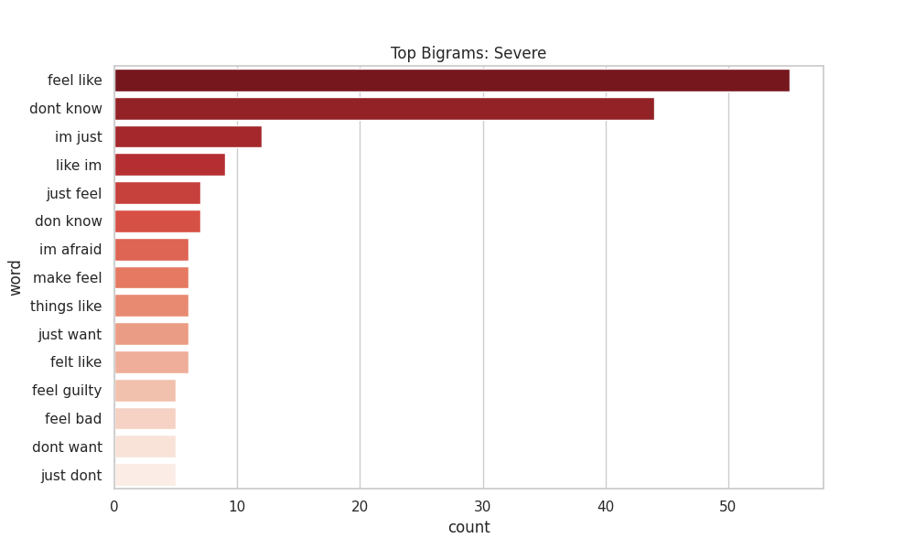
Top Bigram per Multilabel Class

Slide 14
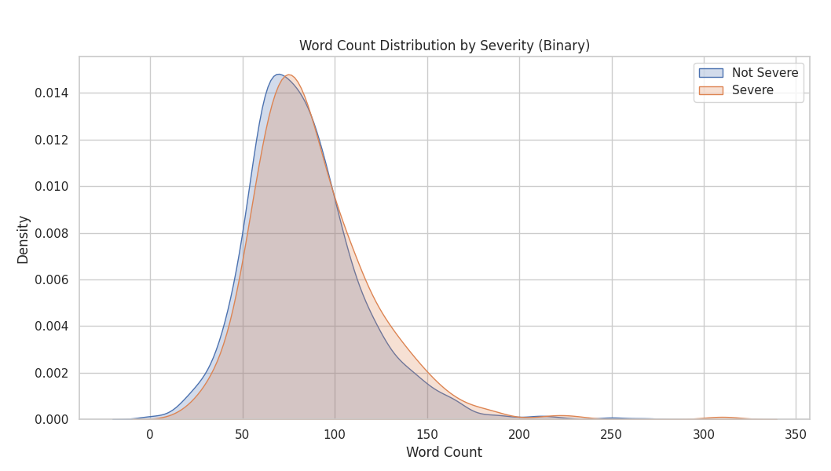
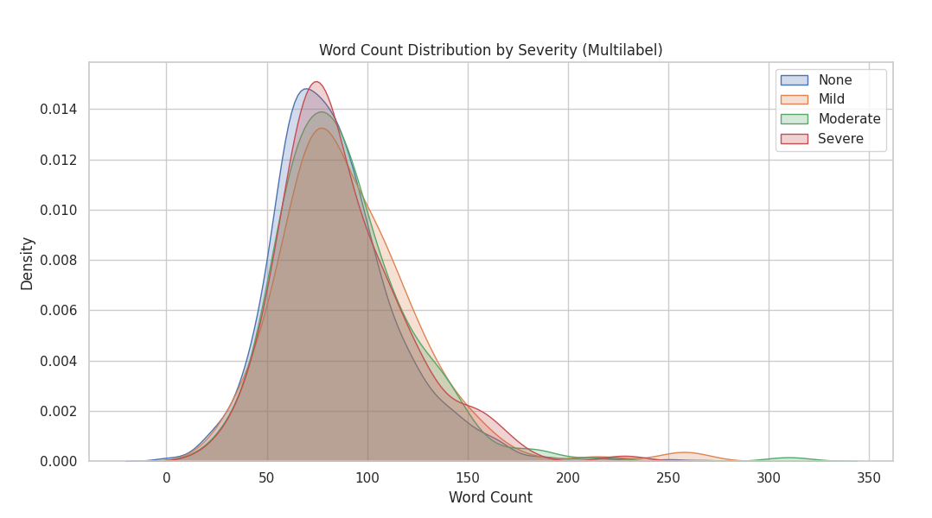
Word Count Distribution by Severity
Most posts are between 50-200 words.
Observation: Severe posts tend to be longer and contain more descriptive emotional narrative.
Why: Longer posts often contain more "context clues" for the model to learn from

Slide 15
Methodology — Model Selection
Text: We tested four different models for every task to find the best balance of speed and F1-Score:
  Logistic Regression: Best for interpretability.
  Linear SVM: Excellent for high-dimensional text data.
  Random Forest: Handles non-linear patterns.
  Naive Bayes: A classic baseline for text classification.
Explanation: We prioritized the Weighted F1-Score because it accounts for the class imbalance better than accuracy.

Slide 16
Binary Task Results & Multilabel Task Results
Binary Task Results (Validation):
Model | Accuracy | Weighted F1-Score
Logistic Regression | 78.25% | 0.7902
Linear SVM | 77.03% | 0.7727
Random Forest | 80.40% | 0.7400
Naive Bayes | 79.33% | 0.7018
Multilabel Task Results (Validation):
Model | Accuracy | Weighted F1-Score
Logistic Regression | 65.68% | 0.6732
Linear SVM | 69.76% | 0.6749
Random Forest | 72.85% | 0.6172
Naive Bayes | 72.86% | 0.6141

Slide 17
Results — Performance Table
Task | Champion Model | Accuracy | Weighted F1-Score
Binary | Logistic Regression | 78.25% | 0.7902
Multiclass | Linear SVM | 69.76% | 0.6749

